Slide 1
ATM Banking Project
Using .Net Framework, Reactjs and mssql server

Slide 2
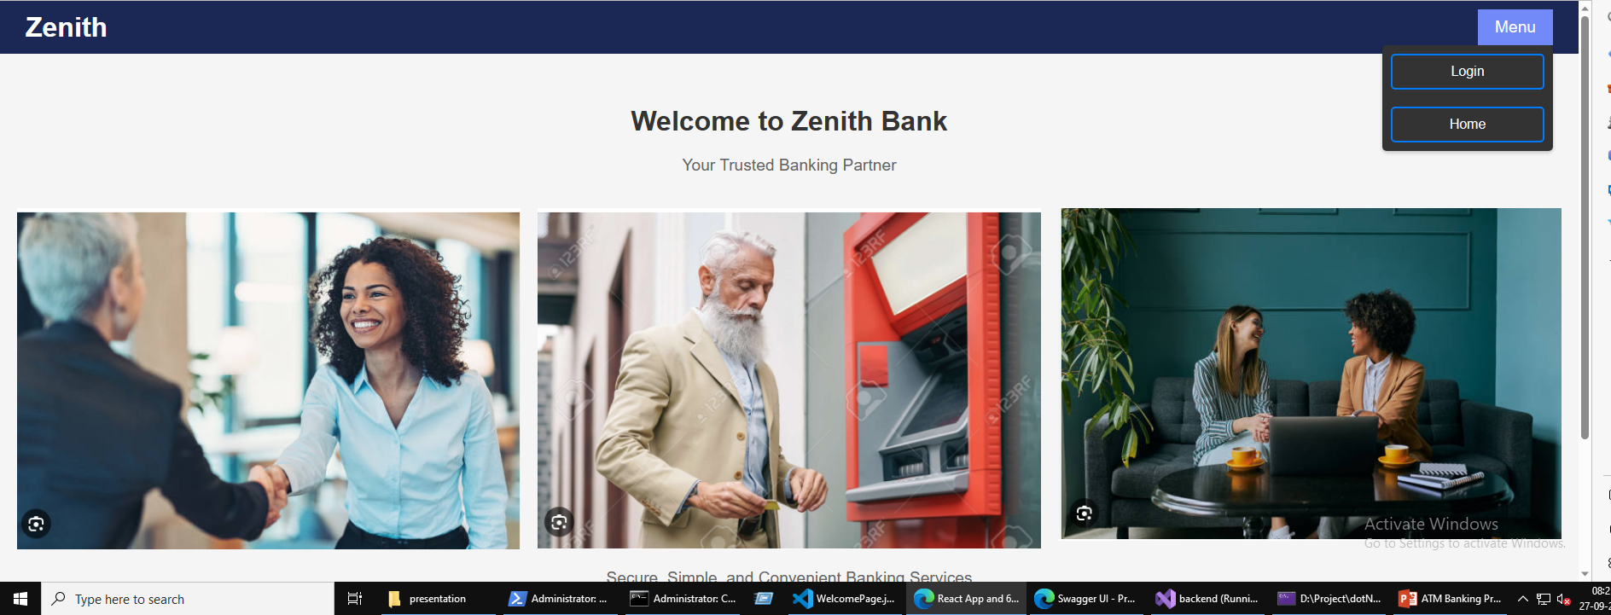
Group 2
Batch 2
Team – Aryan Srivastava, Ishaan Agarwal, Pallavi Buwa, Rwitick Ghosh

Slide 3
Aryan Srivastava
Database storage – Schema
Backend – Repository
Frontend – Multiple pages including Login, Sign-Up, functionalities such as context, protected route, UI/UX design, storage persistence
Ishaan Agarwal
Database storage – Schema
Backend – Context, Utilities
Frontend – Multiple pages including Transactions, Details of account, Create Account, UI/UX design, functionalities such as admin route
Team
Pallavi Buwa
Database storage – Schema
Backend – JWT generation, User Repository, Authorization Service, User Controller, Unit Testing
Frontend – UI/UX design, Navigation bar, Theming and colors
Rwitick Ghosh
Database storage – Schema
Backend – Account Service, Account Controller, Utilities such as password hashing, Authorization middleware, Interface declarations, Unit Testing
Frontend – UI/UX design, Theming and colors

Slide 4
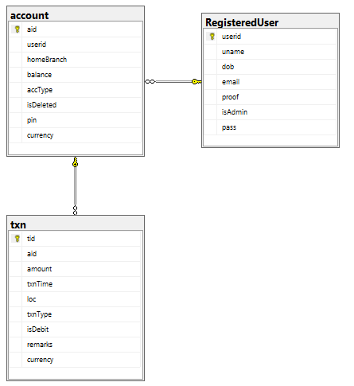
Database Schema

Slide 5
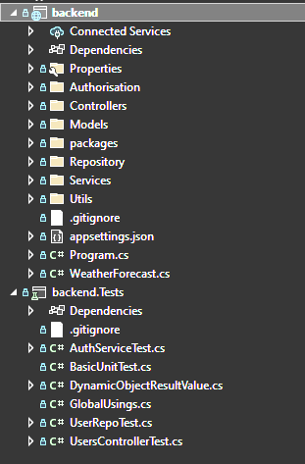
Backend folder structure
As viewed by Visual Studio solution explorer

Slide 6
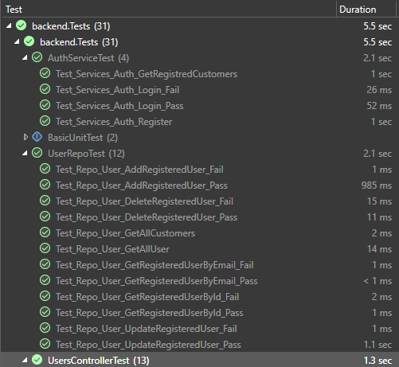
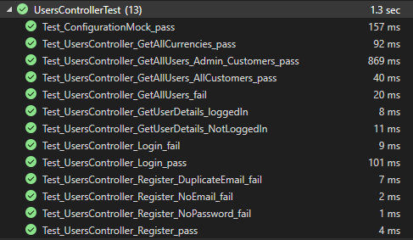
Backend unit test results
As viewed in Visual Studio Test Explorer

Slide 7
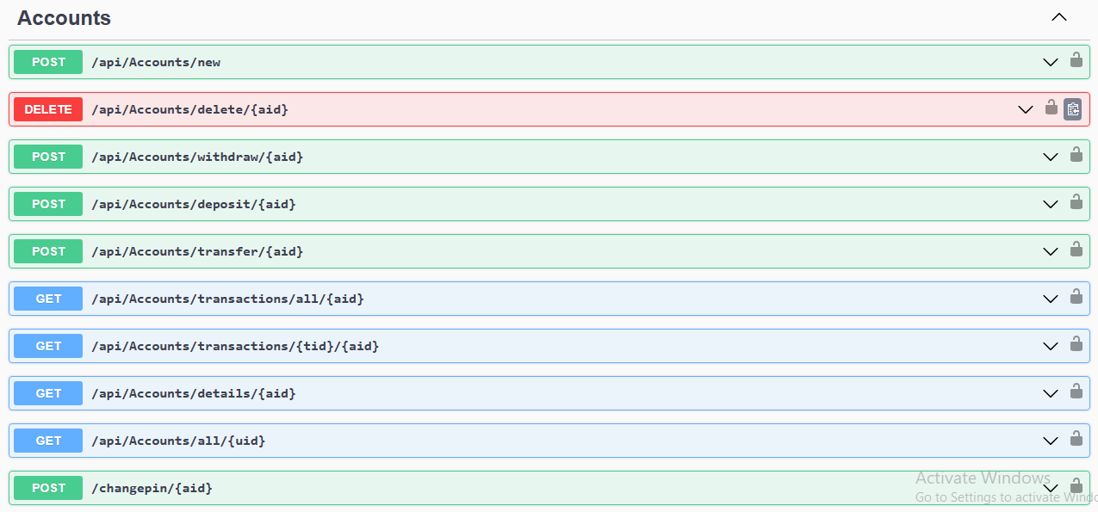
Swagger View
View of the endpoints in Swagger provided by .Net framework

Slide 8
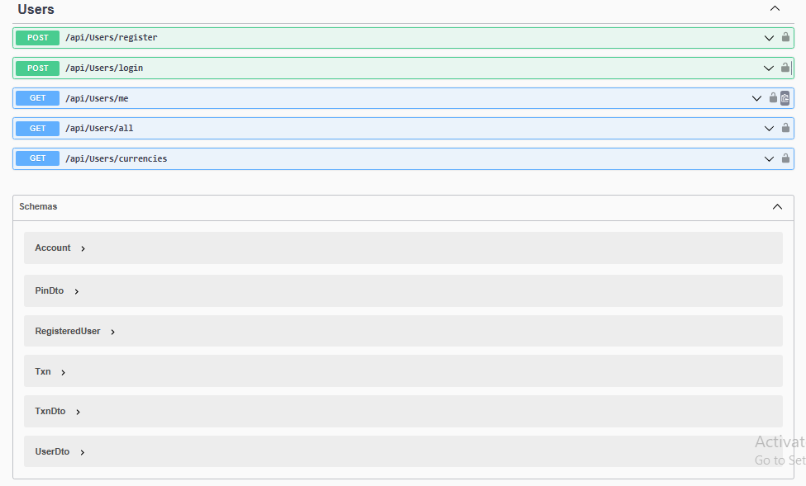
Swagger View (continued…)
View of the endpoints in Swagger provided by .Net framework

Slide 9
Screens
Demo client application screengrabs for functionality view

Slide 10
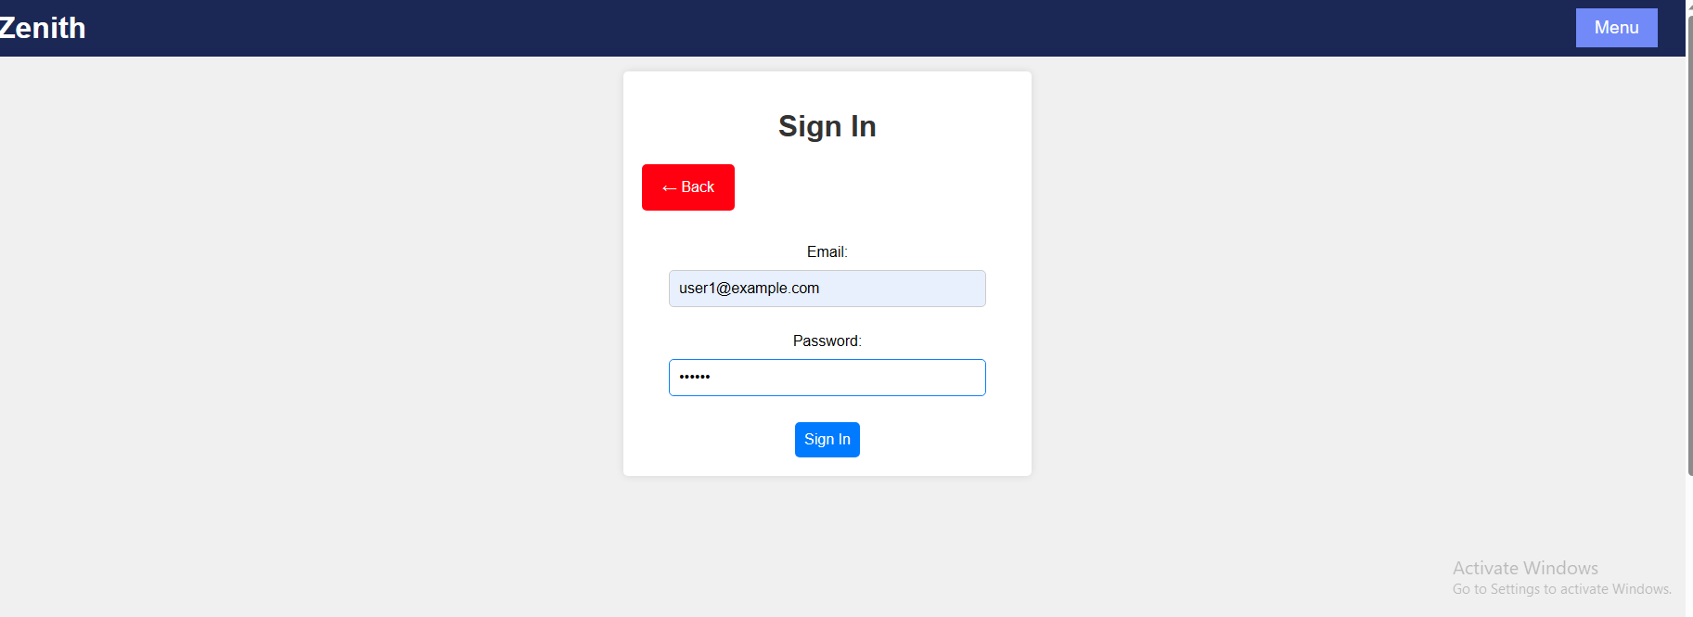
Sign In page
Visible to all users when not logged in

Slide 11

Create a new user page
Visible only to admin after logging in

Slide 12

Create a new bank account page
Visible only to admin after logging in

Slide 13
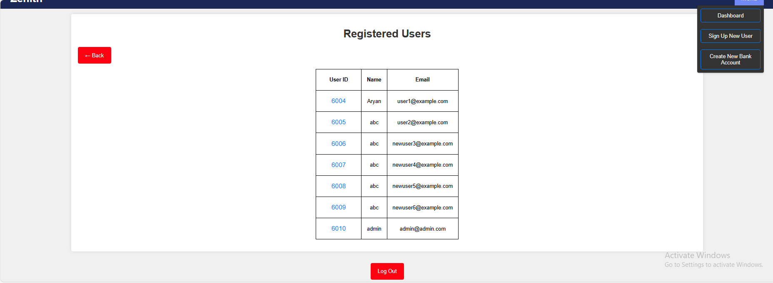
List of registered users page - Admin Dashboard
Visible only to admin after logging in

Slide 14
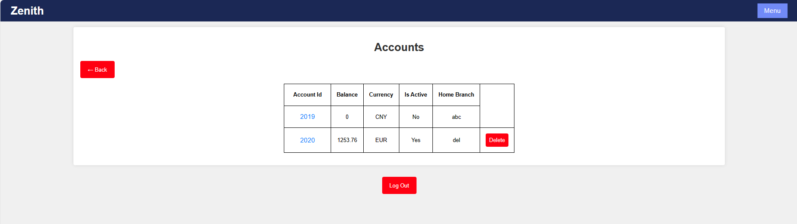
List of accounts for a user page
Visible only to admin & respective user after logging in

Slide 15
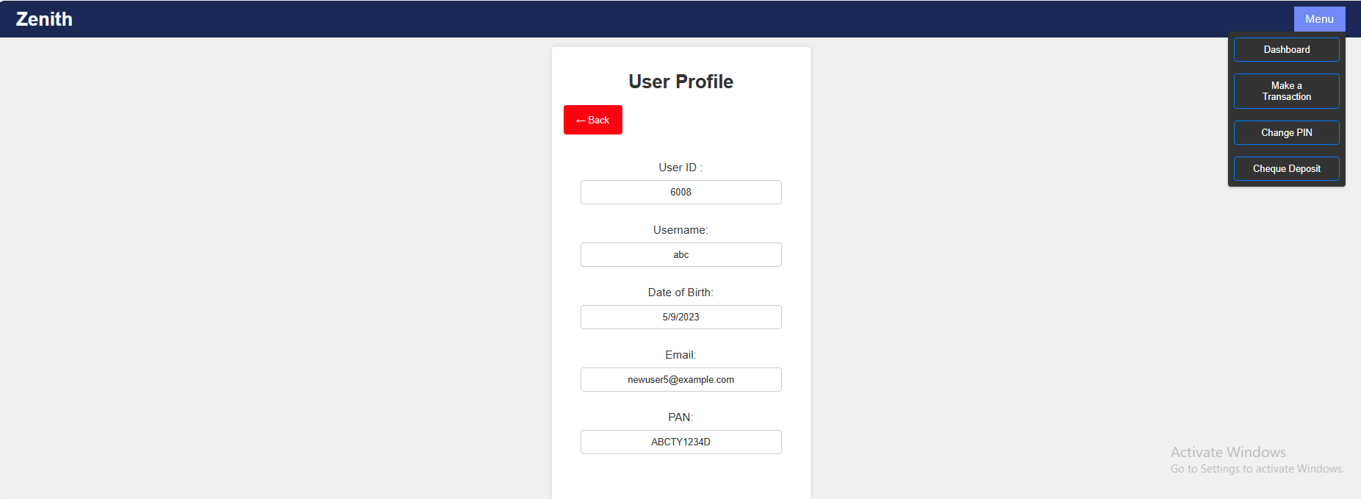
Profile page – User dashboard
Visible to respective user after logging in

Slide 16

Make a transaction page – cash withdrawal, deposit & transfer
Visible to respective user after logging in

Slide 17
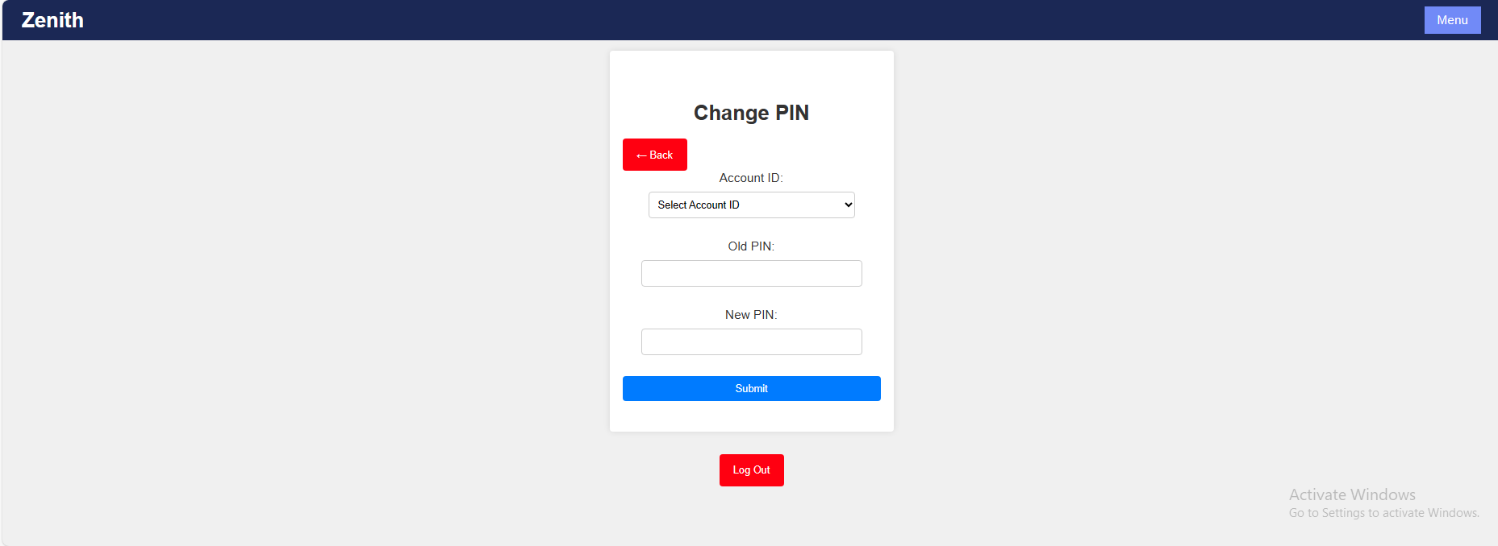
Change PIN page
Visible to respective user after logging in

Slide 18
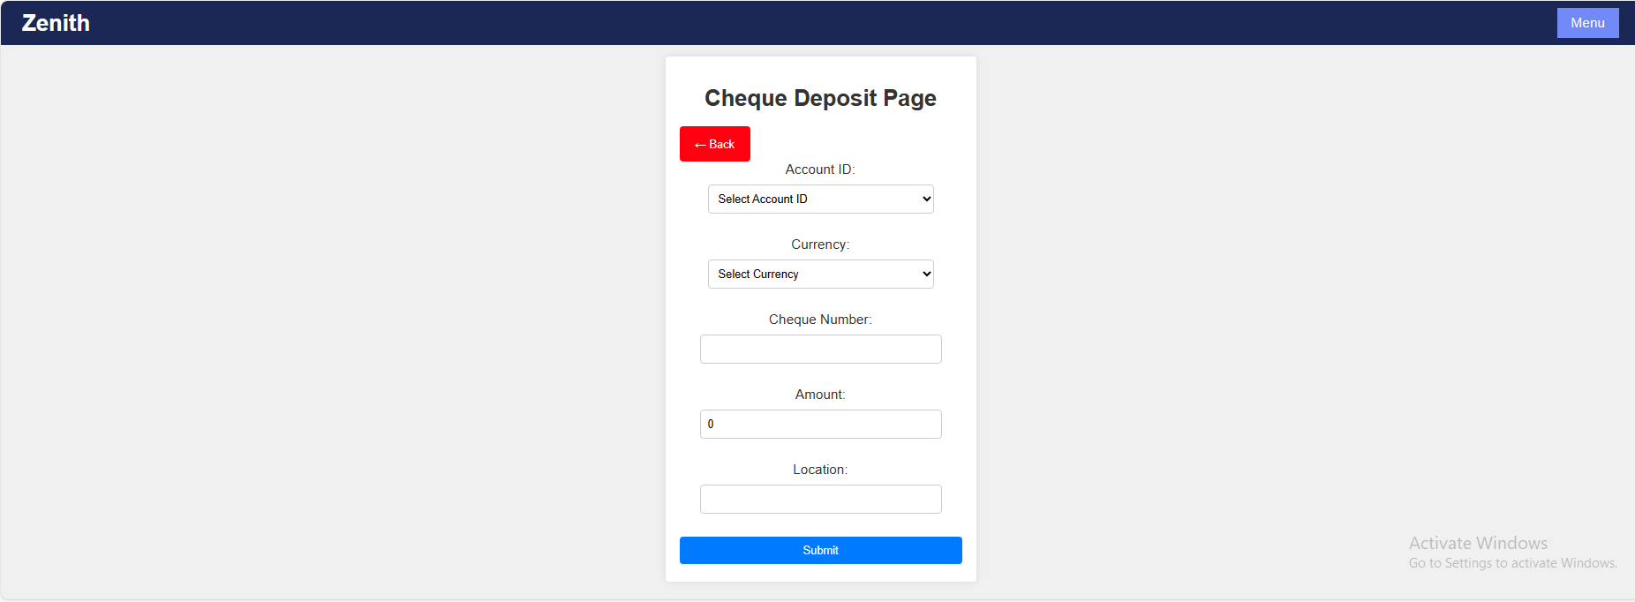
Cheque deposit page
Visible to respective user after logging in

Slide 19
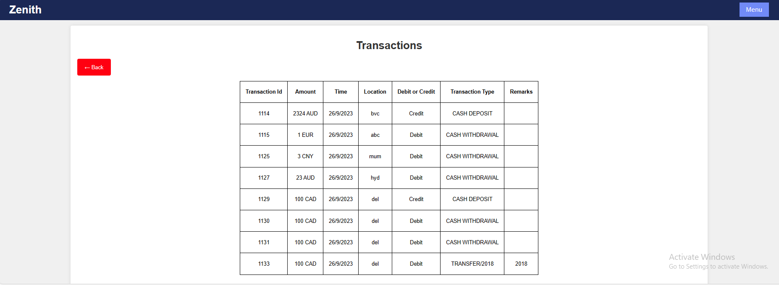
List of account transactions page
Visible to respective user & admin after logging in

Slide 20
Thank You
Group 2, Batch 2 of .Net framework, Hyderabad

